Slide 1
WELCOME

Slide 2


A
SEMINAR ON
“ADVANCE METHODS OF FOOD PROCESSING ”
Under Guidance :- Asst. Prof. S.P. Paulzagde
PRESENTED BY
Kalpesh Mahesh Bagade (EJ- 005/2018)
(Affiliated to Mahatma Phule Krishi Vidyapeeth, Rahuri)
DR. ULHAS PATIL COLLEGE OF AGRI. ENGG. & TECH, JALGAON

Slide 3
Content:
Aim
Introduction
Objective
Materials & Methods
Conclusion
References

Slide 4
TITLE
ADVANCE METHODS OF FOOD PROCESSING

Slide 5
Introduction:
What is Food Processing?
Food processing is the transformation of raw ingredients, by physical or chemical means into food, or of food into other forms.
Food processing combines raw food ingredients to produce marketable food products that can be easily prepared and served by the consumer.

Slide 6
Why it should be processed ?
Food processing
Toxin removal
Enables tramsportation
Suits our life style
Can also add extra nutrients
Increases shelf life
Improves the taste of the food

Slide 7
Objective :-
To study the advance methods of food processing

Slide 8
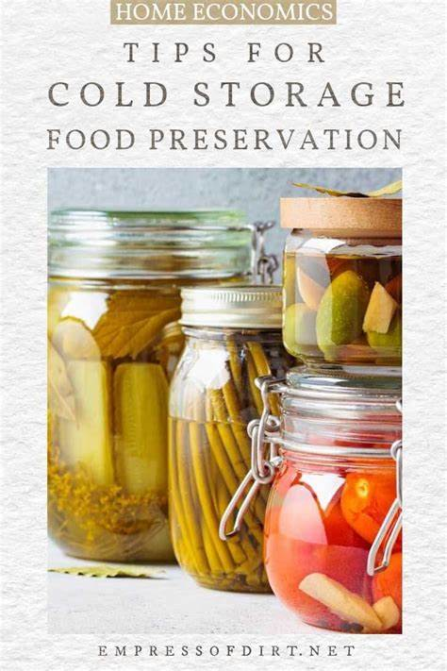
Materials & Methods :-
How it can be processed?
Addition of salt, sugars, preservatives, antioxidants, naturally occurring antimicrobial substances.
Also by the processes like drying, freezing, refrigerated storage, smoking, food concentration, canning etc.
Refrigerated storage

Slide 9
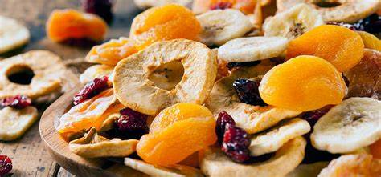
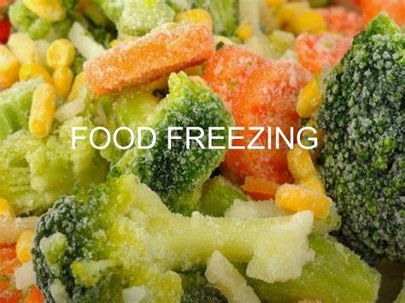
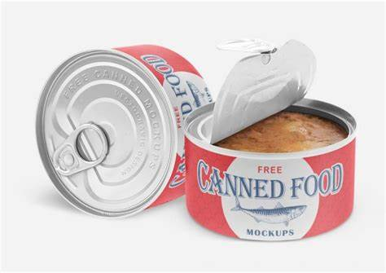
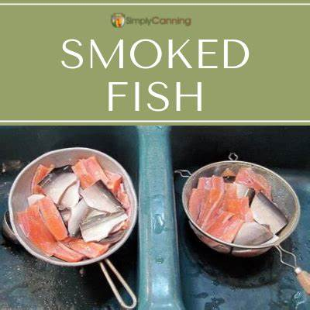
Drying food
Freezing food
Smoking fish food
Canning food

Slide 10
Novel Food Processing Technologies :
Ohmic Heating
Microwave heating
Radiofrequency heating
Infrared heating
High Pressure Processing
Pulsed Electric Field
Super critical fluid extraction
Ultrasonics
Pulsed Light Technology
Pulsed X-rays
Irradiation
Oscillating Magnetic Field

Slide 11
Microwave Heating:
Refers to use electromagnetic waves of certain frequencies (2450 to 9145MHz)
Container with food is placed in a microwave oven.
And then a oven is activated, the food at the edge of the container heats faster and a temperature gradient develops between the center and the edges

Slide 12
Mechanism:
Dipolar interaction: polar molecules such as water molecules (dipole) inside the food will rotate according to the alternating electromagnetic field. The rotation of water molecules would generate heat for cooking.
Ionic interaction: Ionic compounds (i.e. dissolved salts) in food can also be accelerated by the electromagnetic field and collided with other molecules to produce heat.

Slide 13
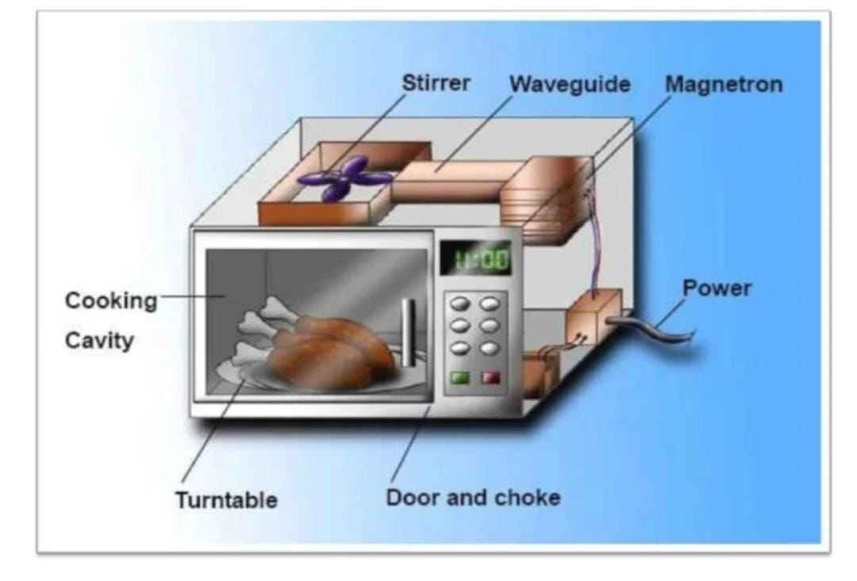
Novel Food Processing Technologies:

Slide 14
Basic components:
Power supply and control: It controls the power.
Magnetron: It is a vacuum tube in which electrical energy is converted to an oscillating electromagnetic field.
Waveguide: It is a rectangular metal tube which directs the microwaves generated from the magnetron to the cooking cavity
Stirrer: Distribute microwaves from the waveguide and allow more uniform heating of food
Turntable: It rotates the food products through the fixed hot and cold spots inside the cooking cavity.
Cooking cavity: It is a space inside which the food is heated when exposed to microwaves
Door and choke: The door and choke are specially engineered that they prevent microwaves from leaking through the gap between the door and the cooking cavity
Materials: Plastic containers, high density polyethylene, papers and boards.
Application: baking, concentration, cooking, curing, drying, finish drying, freeze drying, pasteurizing, sterilizing, tempering and thawing.

Slide 15
PULSED ELECTRIC FIELD (PEF)TECHNOLOGY
PEF is a non-thermal food preservation technology that involves the discharge of high voltage electric pulses (up to 70 kV/cm) into the food product, which is placed between two electrodes for a few microseconds.
An extemal electric field is used to exceed a critical transmembrane potential of one volt.
This result in a rapid electric breakdown and conformational changes of cell membranes, which leads to the release of intracellular liquid, and cell death.
PEF treatment shows changes in tissue structure leading to weight increase and greater water holding capacity and less loss during cooking.

Slide 16
PULSED ELECTRIC FIELD :
A power supply: this may be an ordinary direct current power supply or a capacitor charging power supply.
An energy storage element: either electric (capacitive) or magnetic (inductive).
A switch which may be either closing or opening
A pulse shaping and triggering circuit in some cases.
A treatment chamber: a wide variety of designs have been developed.
A pump: to supply a feed of product to the chamber.
A cooling system; to control the temperature of the feed and/or output material

Slide 17
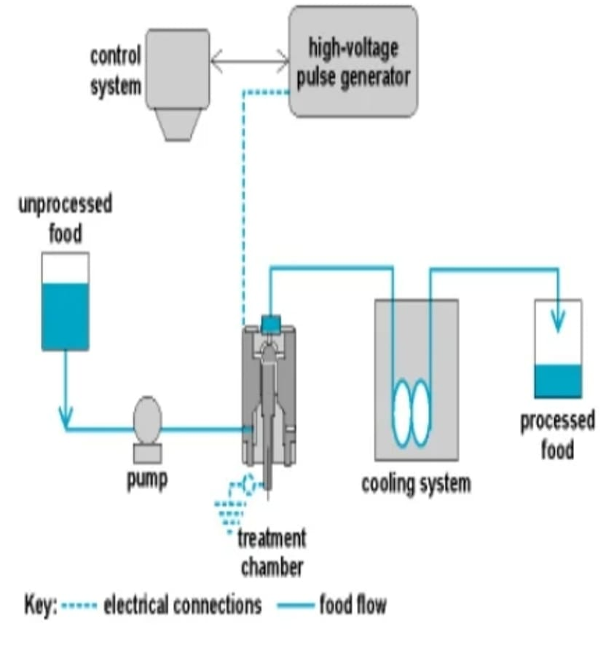
PULSED ELECTRIC FIELD:

Slide 18
Mechanisms of Microbial Inactivation:
Electrical Breakdown: The normal resisting potential difference across the membrane is 10 mV and is proportional to the field strength and radius of the cell. The increase in the membrane potential leads to reduction in the cell membrane thickness.
Electroporation: The plasma membranes of cells become permeable to small molecules after being exposed to an electric field, and permeation then causes swelling and eventual rupture of the cell membrane
Applications: PEF is used in processing of apple juice, orange juice, processing of milk, liquid whole eggs, baking applications and processing of green pea soup.
Advantages:
Kills vegetative cells.
Colors, flavours and nutrients are preserved.
Short treatment time.

Slide 19
HIGH PRESSURE PROCESSING: (HPP)
High Pressure Processing is also known as "High Hydrostatic Pressure" or "Ultra High Pressure" processing.
HPP uses up to 900MPa to kill many of the micro organisms found in foods, even at room temperature without degrading vitamins, flavor and colour molecules in the process.
Food packages are loaded onto the vessel and the top is closed.
The pressure medium usually water is pumped into the vessel from the bottom.

Slide 20
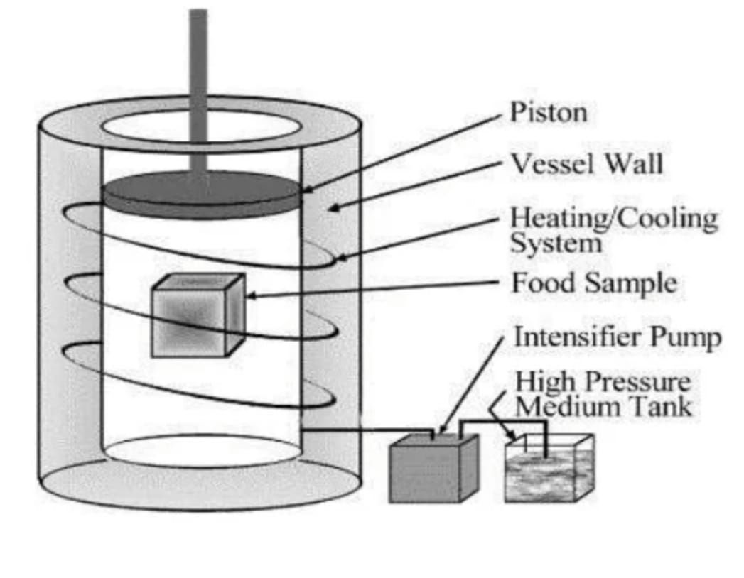
HIGH PRESSURE PROCESSING: (HPP)
Components:
A pressure vessel and its closure
A pressure generation system
A temperature control device
A materials handling system
Two processing foods:
1.In container processing
2.Bulk processing

Slide 21
About hydrostatic pressure:
Hydrostatic pressure is applied to food products through a water bath that surrounds the product.
The hydrostatic pressure is transmitted to food products equally from all sides.
This equal distribution of pressure is the reason why foods are not crushed during treatment.
This type of pressure also has little effect on covalent bonds, and as a result, the foods being processed do not undergo significant chemical transformations.

Slide 22
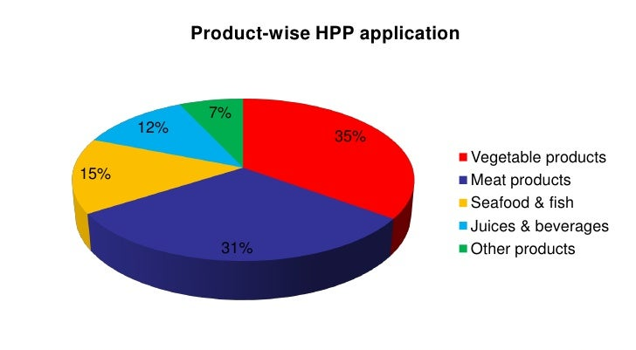
Product wise HPP application:

Slide 23
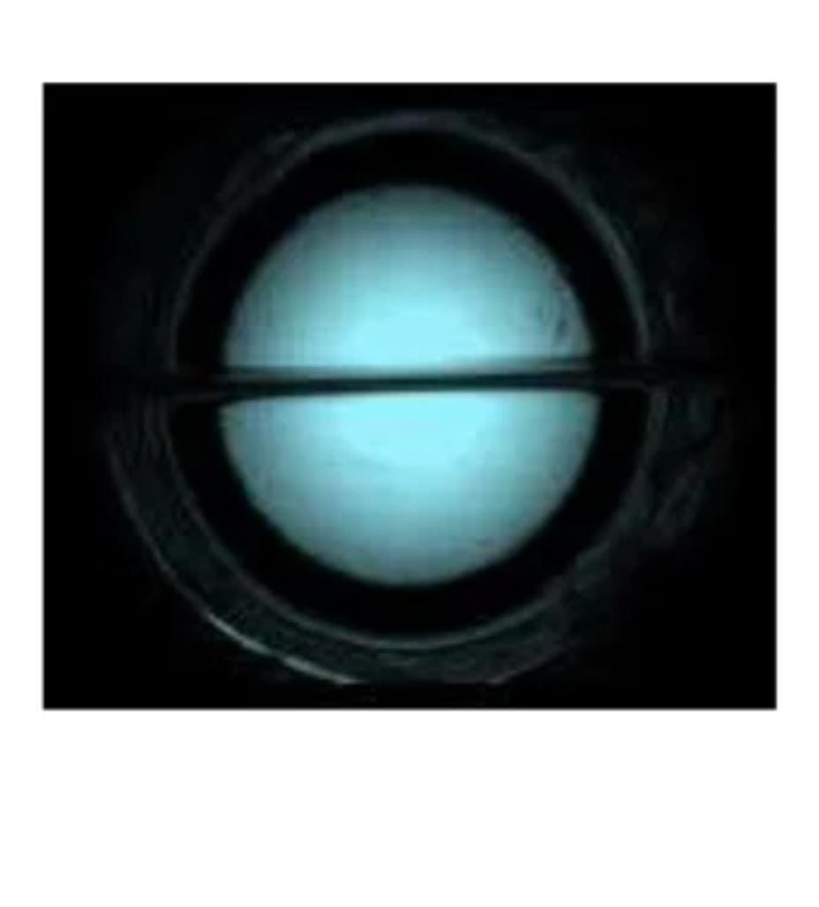
What is SCF ?
Supercritical fluid is a state of matter that is intermediate between a gas and liquid in its properties.
The temperature and pressure at which the point occurs are known as the Critical Temperature and Critical Pressure and are characteristic of the solvent.
Beyond this point, the solvent will be neither a gas nor a liquid, but will possess the properties of both phases.

Slide 24
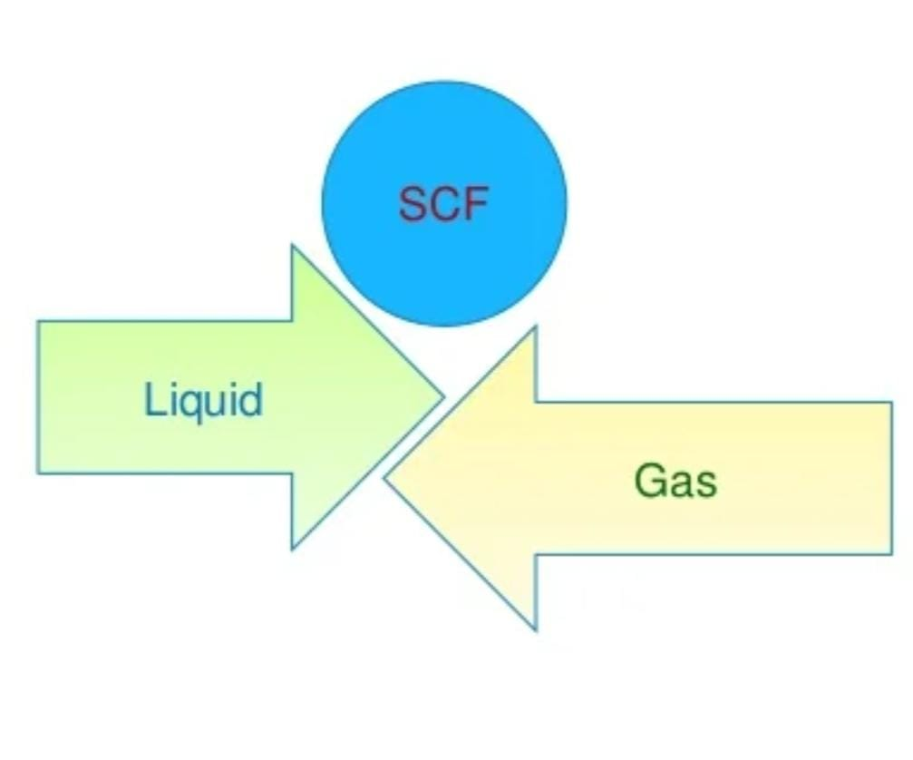
Principles of Supercritical Fluids (SCFs)....
A supercritical fluid (SCF) is any compound at a temperature and pressure above the critical point.
Above the critical temperature (Tc) of a compound, the pure, gaseous component cannot be liquefied even by increase in pressure.
The critical pressure (Pc) is the vapor pressure of the gas at the critical temperature.

Slide 25
Process of SCF extraction:
The system consists of a pump, a pressure cell to contain the sample and a collecting vessel.
The supercritical fluid diffuses into the matrix
The analyte gets dissolved into the supercritical fluid
The dissolved material is swept from the extraction cell into a separator at lower pressure and the extracted material settles out.
The CO2 can be cooled and recycled or discharged to atmosphere.
The pressure requirement is at least 74 bars. Most extractions are conducted at less than 350 bar.

Slide 26
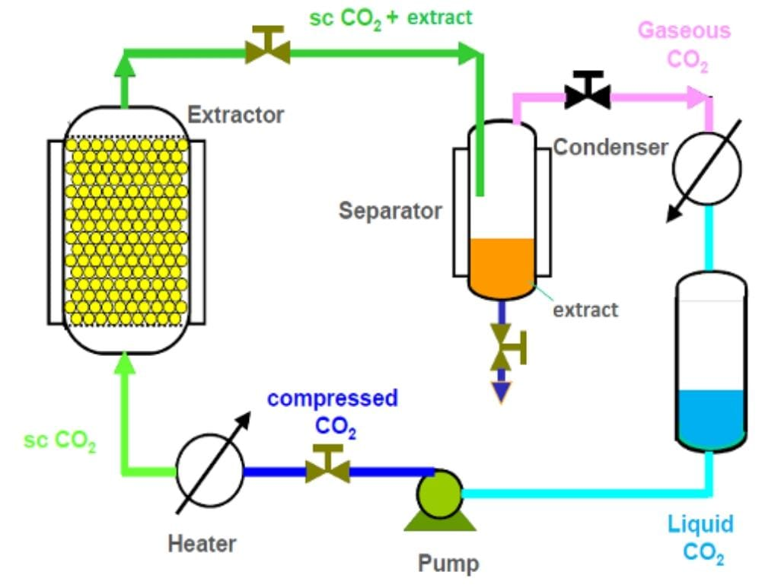
Process of SCF extraction :

Slide 27
Why Non thermal?
The main problem with the thermal processing of food is loss of volatile compounds, nutrients, and flavour.
To overcome these problems non thermal methods came into food industries to increase the production rate and profit.
The non thermal processing is used for all foods for its better quality, acceptance, and for its shelf life.
The new processing techniques are mostly employed to the liquid packed foods when compared to solid foods.

Slide 28
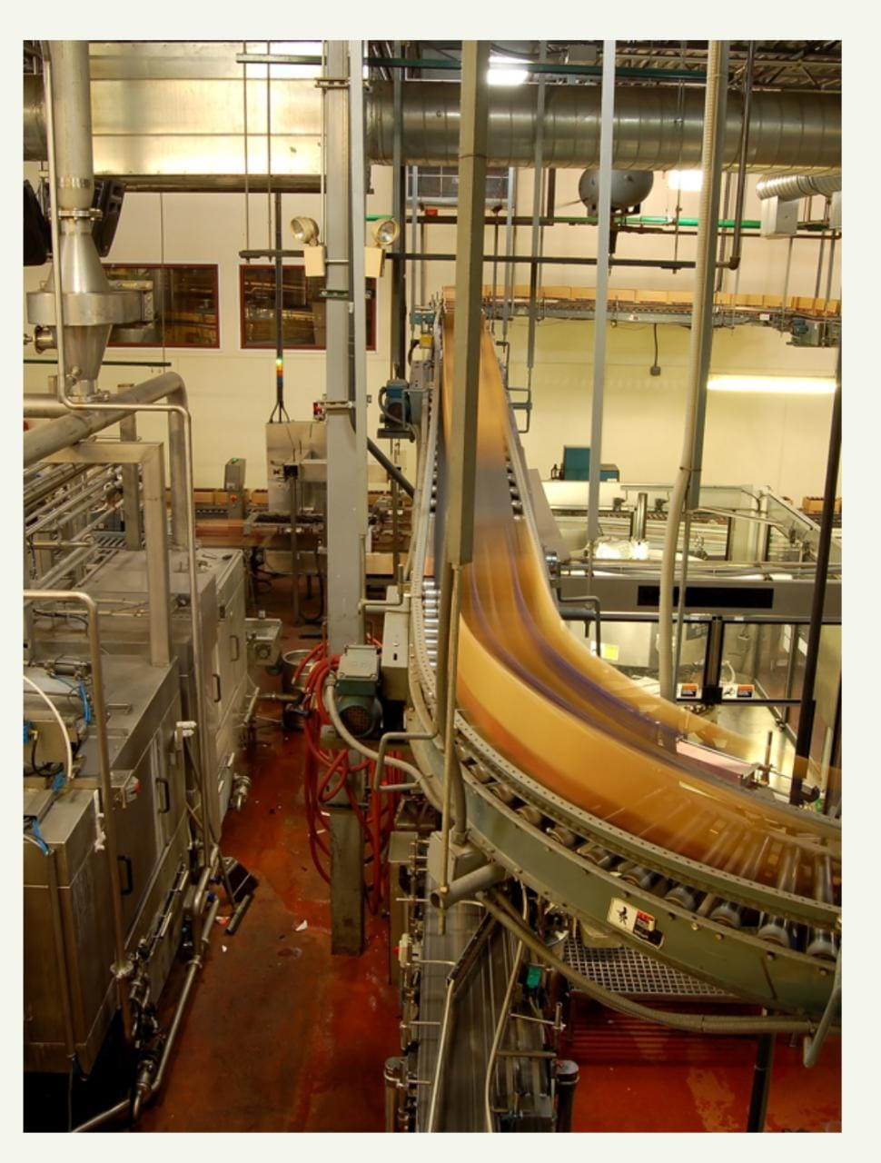
Why Non thermal?
Since the non thermal methods are used for bulk quantities of foods, these methods of food preservation are mainly used in the large scale production.
The cost of equipments used in the non thermal processing is high when compared to equipments used in thermal processing.
After minimizing the investment costs of non thermal processing methods, it can also be employed in small scale industries.

Slide 29
Conclusion
Traditional methods :-
Time consuming.
Nutrient loss during processing.
Modern methods :-
Retain more nutrient.
Less time requirement.
Most of the non thermal methods which preserve flavoring and bioactive compounds.
More efficient over traditional processing methods.

Slide 30
References:
www.wikipedia.com
www.slideshare.com

Slide 31
Thank You…!

